Slide 1
DAYALEKTOR
Belchez, Maica L. Carpio, Aira Joyce A. Gardon, Jana Marie G. Haboc, Florence Gail G.

Slide 2
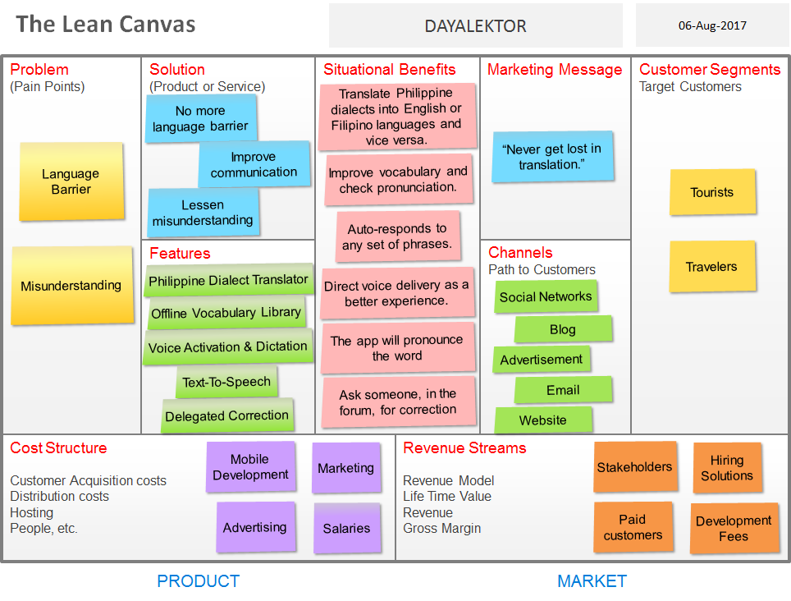

Slide 3
GENERAL COMPANY DESCRIPTION

Slide 4
Mission(s):
To provide a tool that connects people to local Filipino users, bring them together, share, and create information.
To improve communication and deliver information in multiple dialects.

Slide 5
Vision(s):
To bring local dialects to life.
To improve human interactions in the Philippines.

Slide 6
Goal(s):
To be one of the most successful and trusted company in the Philippines.

Slide 7
Objective(s):
To be able to help users in regard to language barriers and misunderstanding between foreign people or Filipino people.
To let users be familiarized with Filipino dialects.

Slide 8
PRODUCTS AND SERVICES

Slide 9
Dayalektor offers the following services:
Languages
English
Filipino
Dialects
Bikol
Cebuano
Hiligaynon (Ilonggo)
Ilocano
Kapampangan
Pangasinan
Tagalog
Waray

